Slide 1



UNIT 3
LESSON 12
Looking forward to the future
Part 2

Slide 2
people/tomorrow/today/to/ for/ the/it/who/prepare/belongs
Tomorrow belongs to people who prepare for it today.
passport/education/future/the/the/to/is
Education is the passport to the future.
We should all be concerned about our future because spend/have/rest/will/lives/ we/our/the/the/of/to/ there.
We should all be concerned about our future because we will have to spend the rest of our lives there.

Slide 3
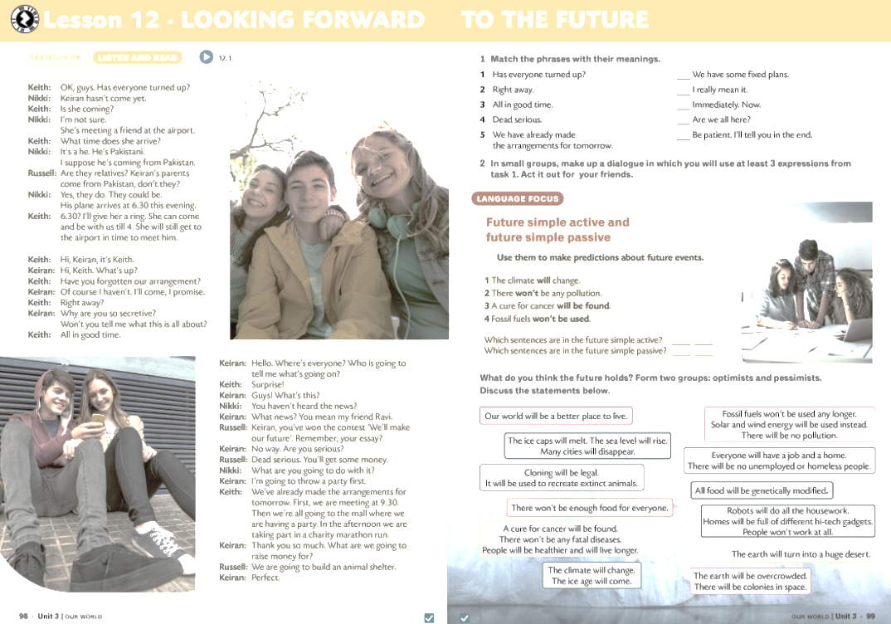
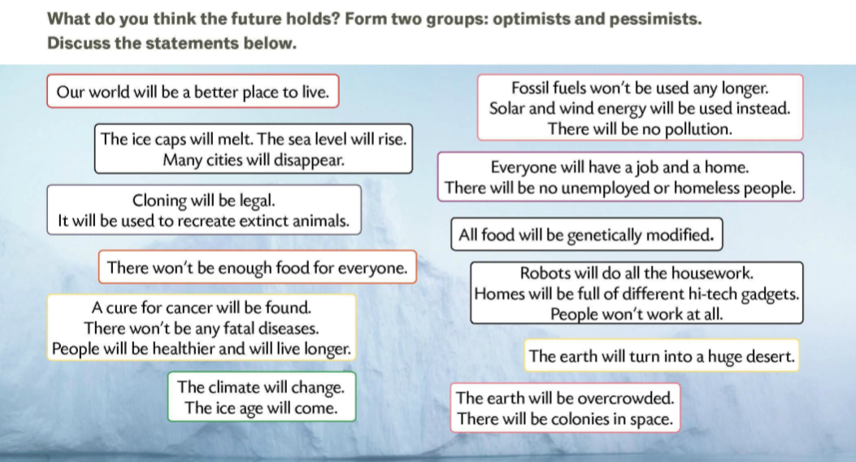
OPTIMISTS
PESSIMISTS
O
O
P
O
O
P
P
O
O
P
P
P

Slide 4
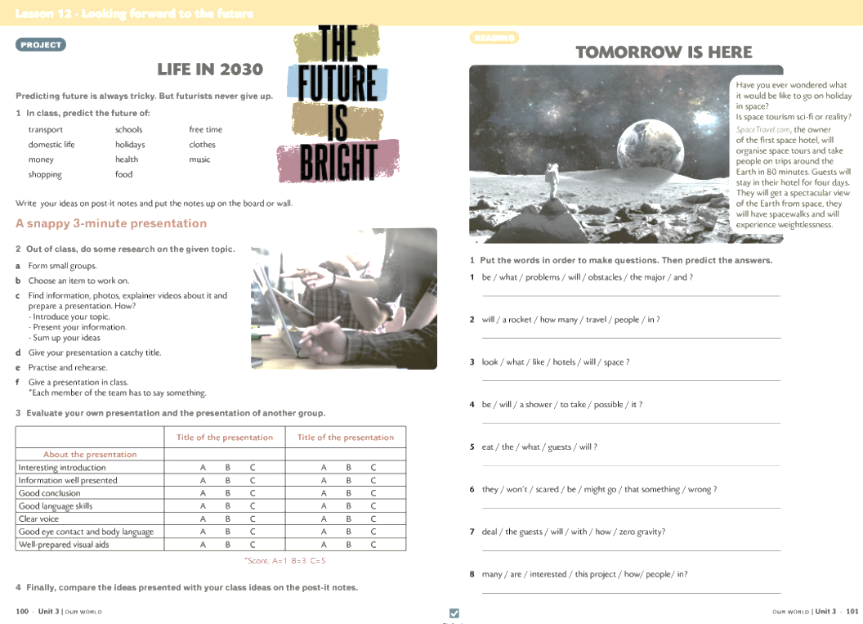
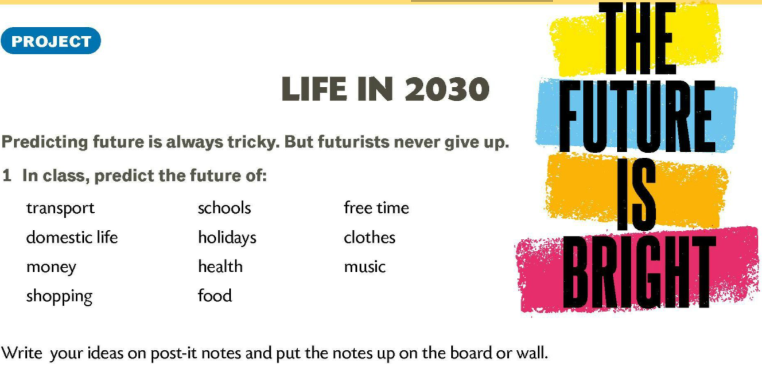

Slide 5
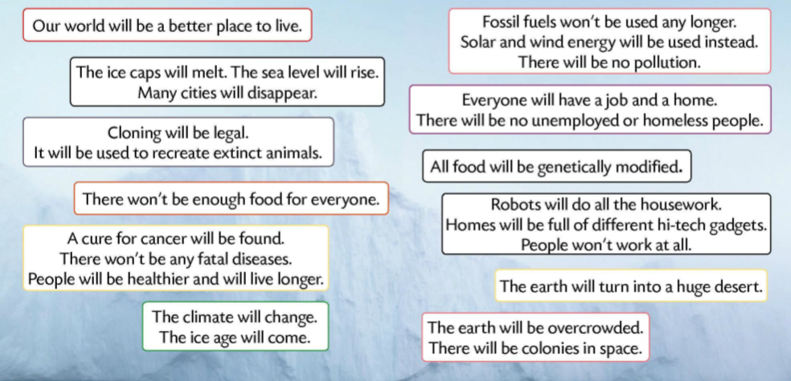

Slide 6
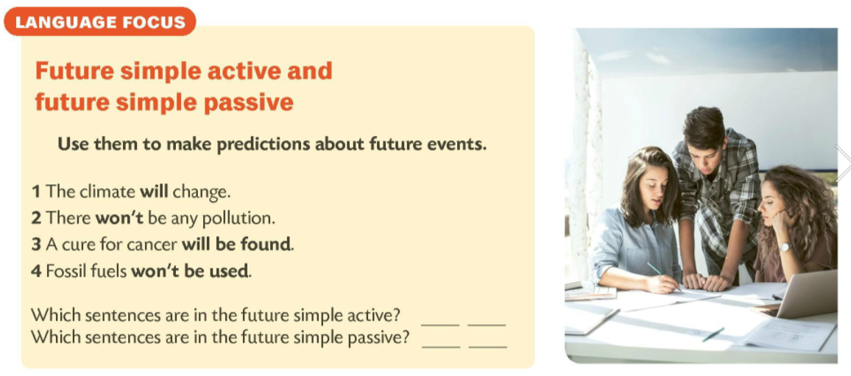

1
2
3
4

Slide 7
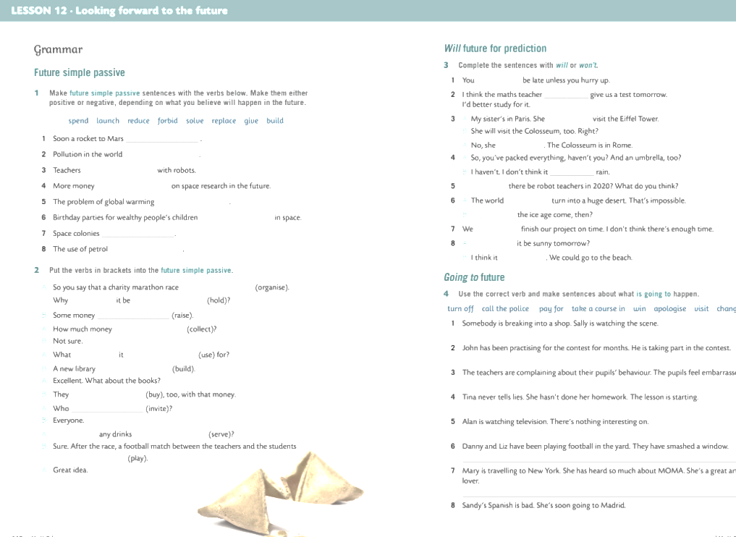
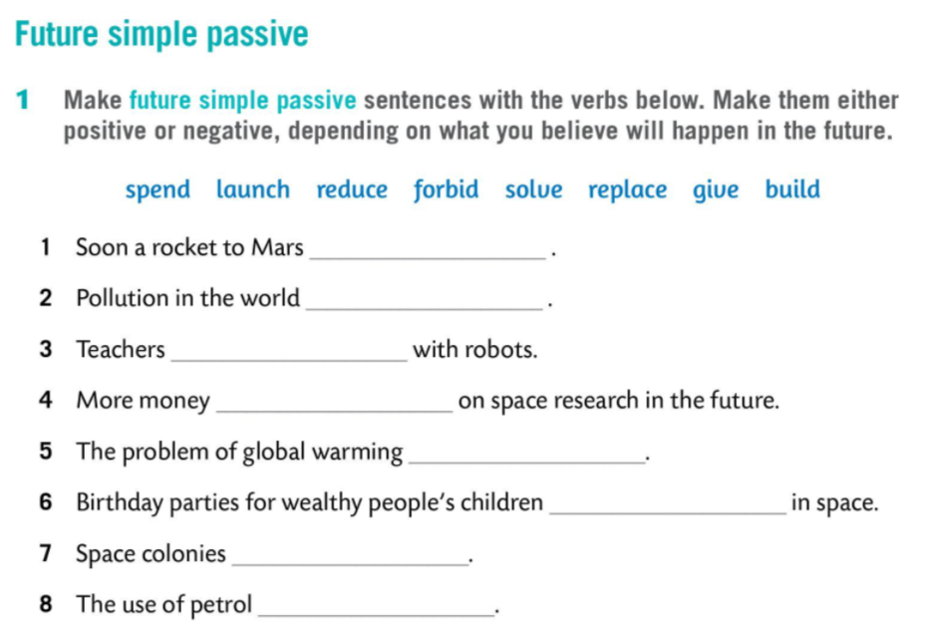
will be launched
will be reduced
will be replaced
will be spent
will be solved
will be given
will be built
will be forbidden

Slide 8
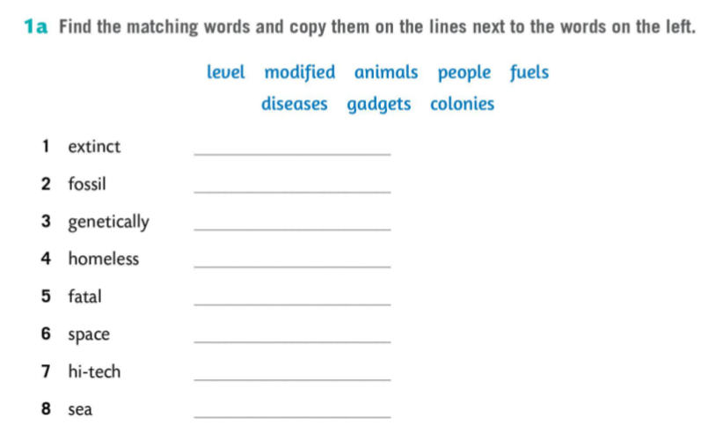
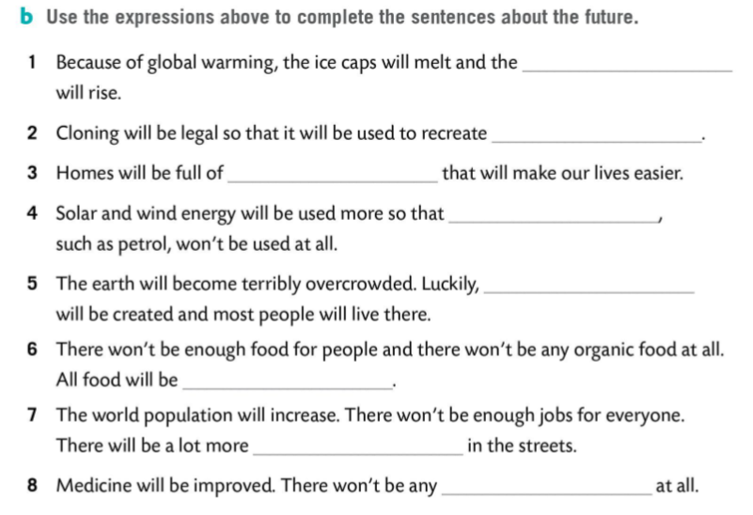
animals
fuels
modified
people
sea level
diseases
colonies
extinct animals
gadgets
high-tech gadgets
level
fossil fuels
space colonies
genetically modified
homeless people
fatal diseases

Slide 9
